Slide 1
How to Extract Machine ID

Slide 2
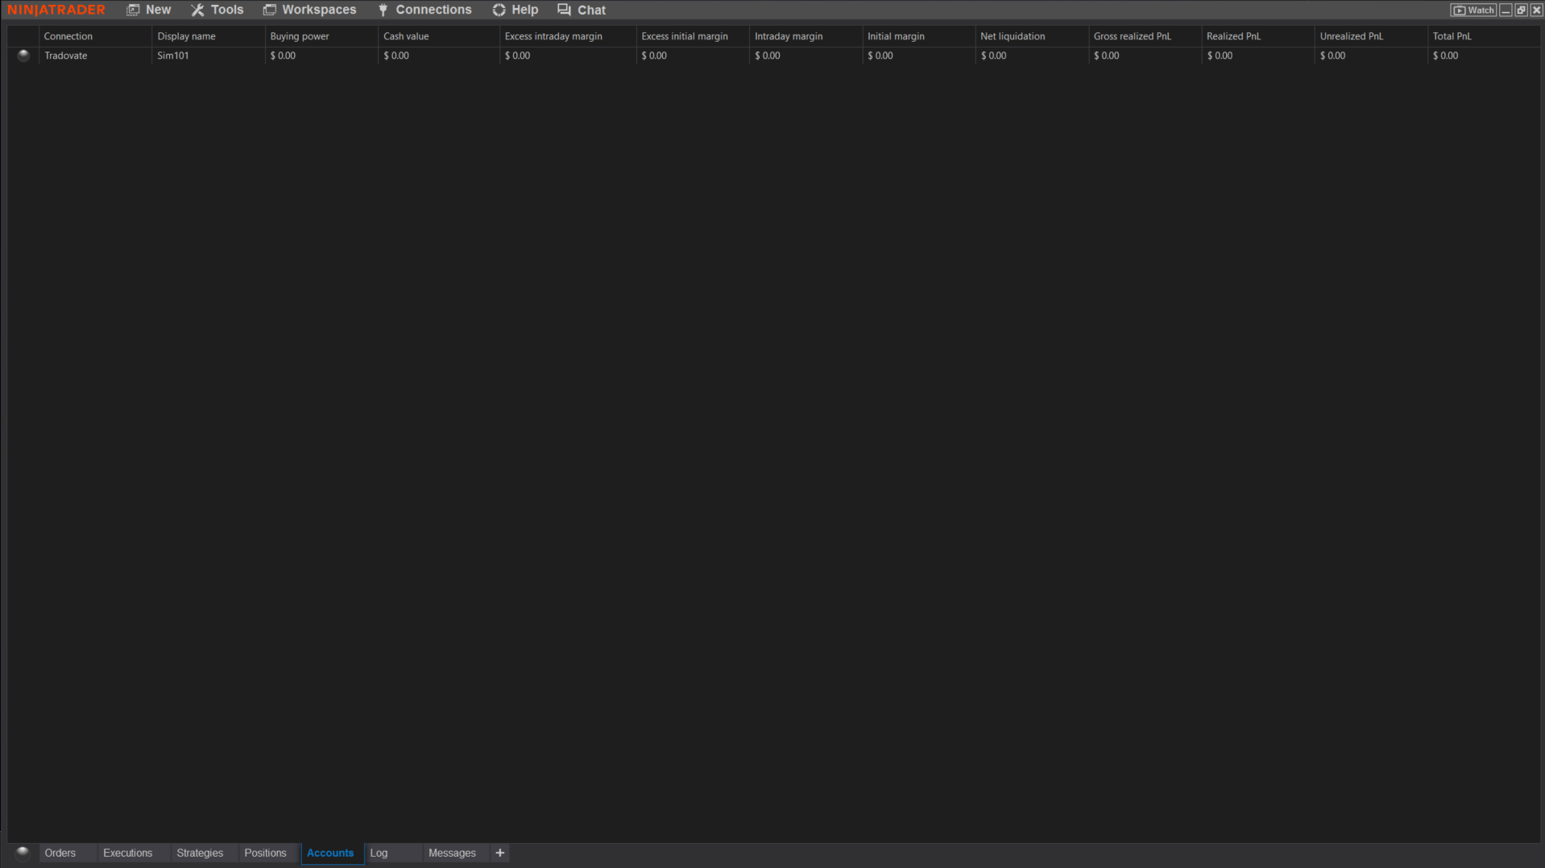
Step 1: Go to the Control Centre
2

Slide 3
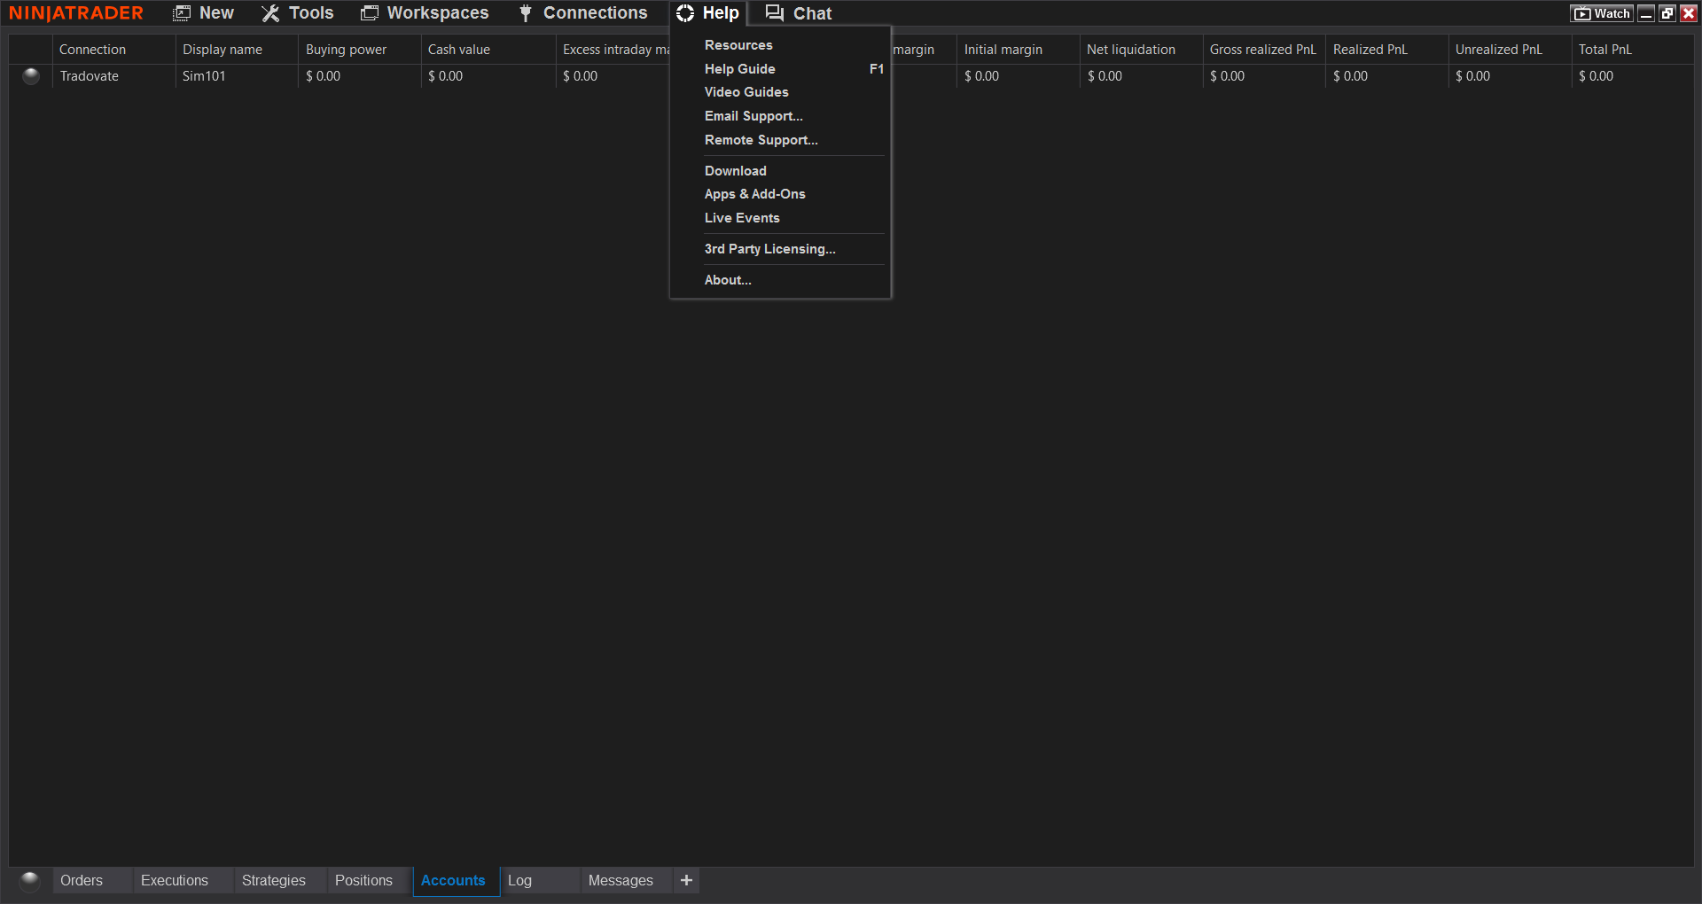
Step 2: Go to Help
3

Slide 4
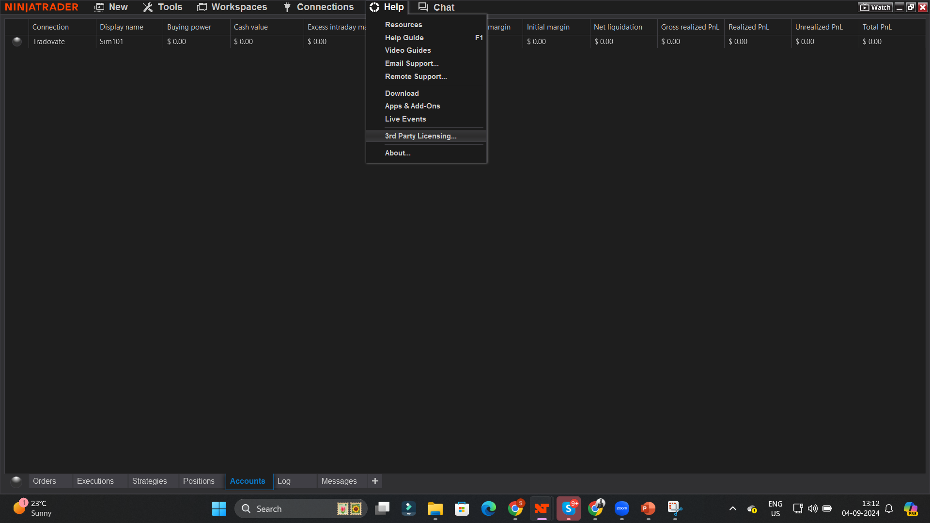
Step 3: Go to 3rd Party Licensing
4

Slide 5
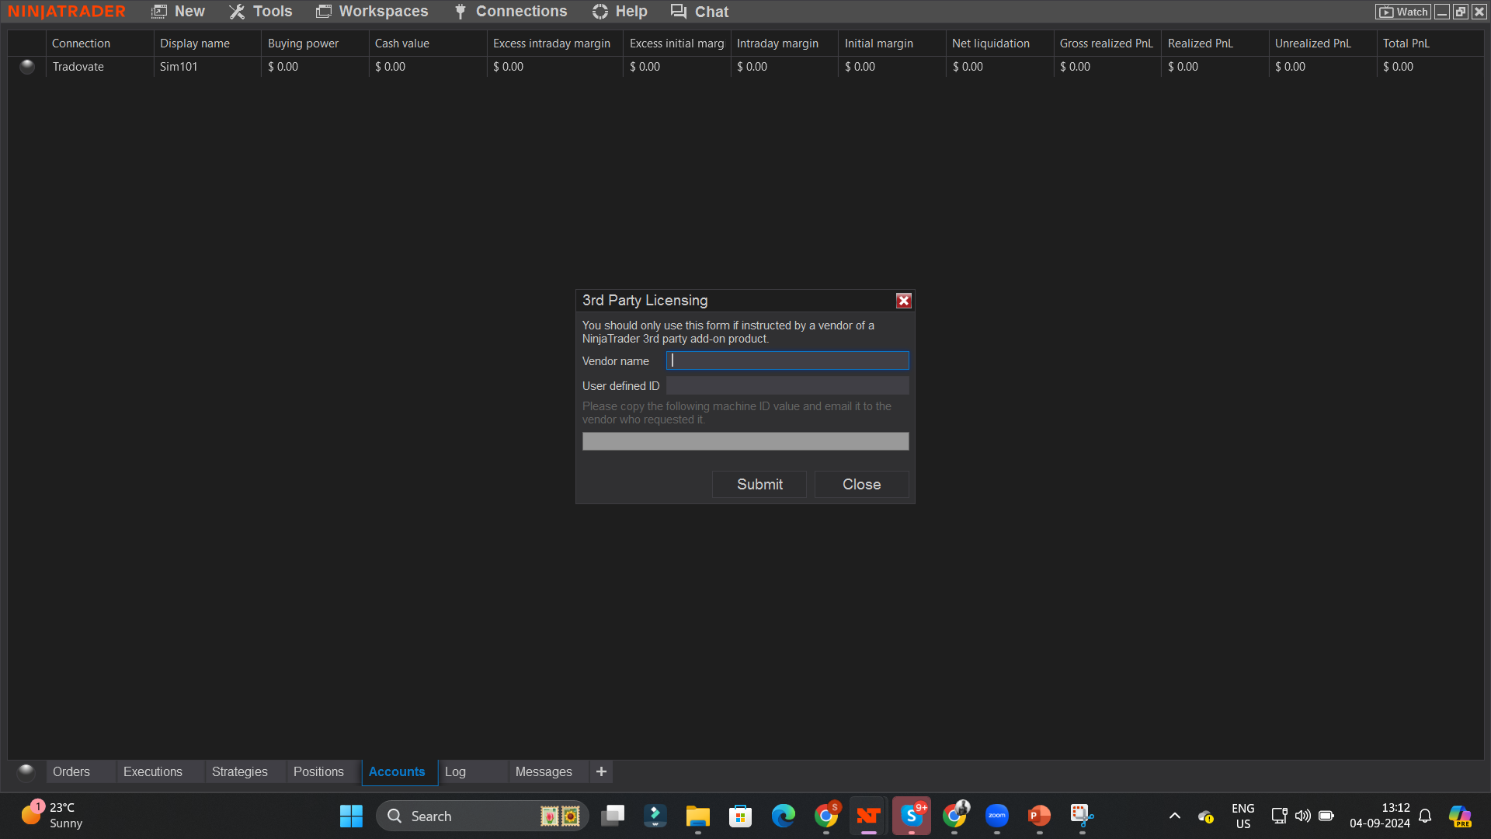
Step 4: 3rd Party Licensing Window
5

Slide 6
Step 5: Enter Vendor name: SniperAutoTraderLLC
6

Slide 7
Step 6: Enter User Defined: put your name here
7

Slide 8
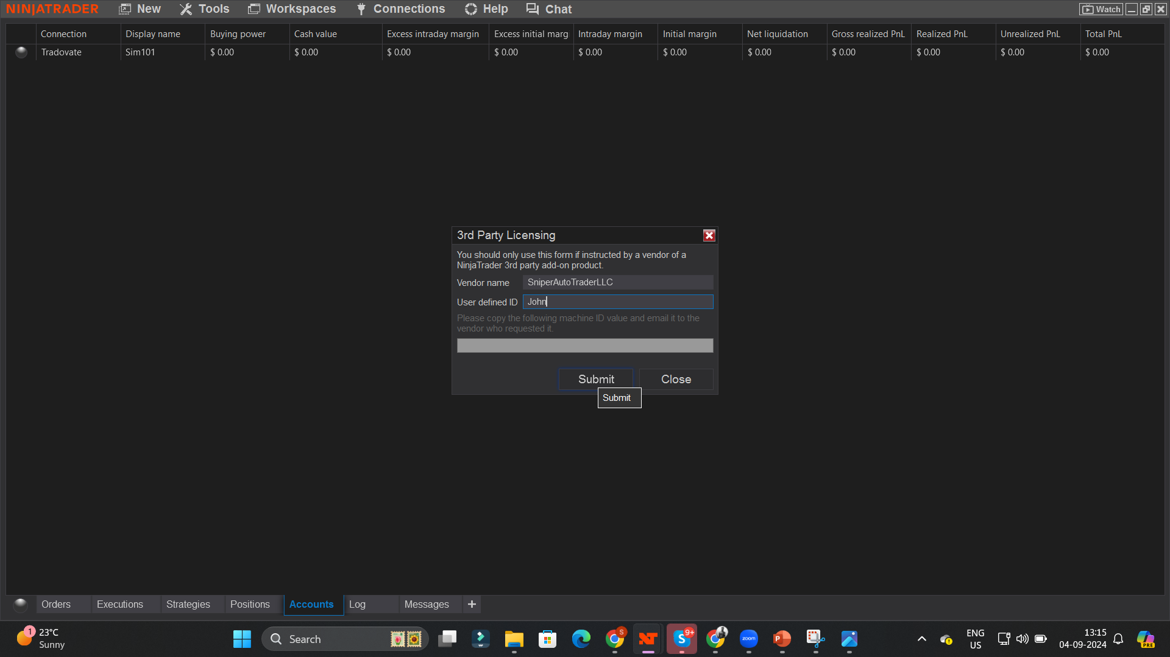
Step 7: Click Submit
8

Slide 9
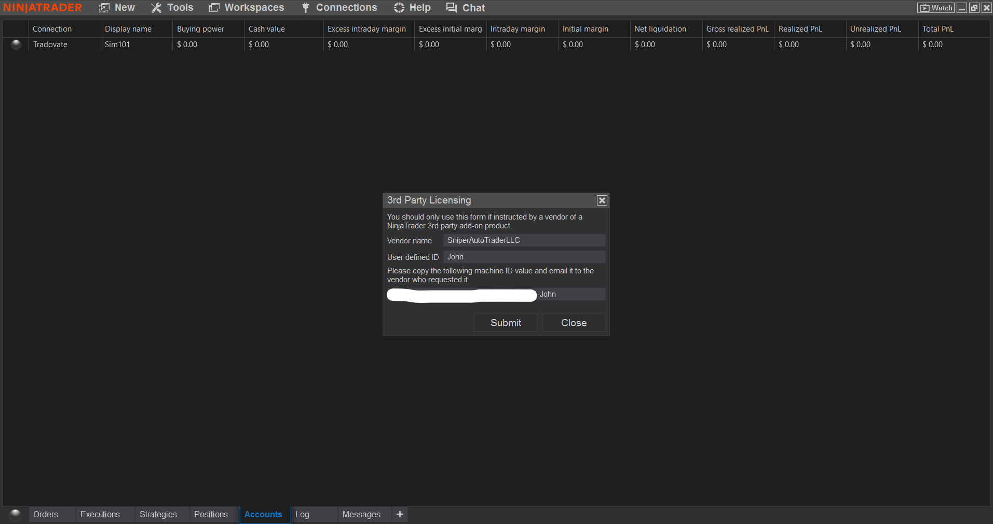
Step 8: Copy the Machine ID
9

Slide 10
Step 9: Send the machine ID on support@sniperautotrader.com
10

Slide 11
11

